Slide 1


Operating an Emergency Operation Center: COVID-19 Considerations
The mark “CDC” is owned by the US Dept. of Health and Human Services and is used with permission..
Use of this logo is not an endorsement by HHS or CDC of any particular product, service, or enterprise.

Slide 2


Objectives
This presentation is intended to:
Discuss how an EOC operates
Explain EOC modes and levels
Define EOC activities during operation, with an emphasis on the context of the COVID-19 response

Slide 3
EOC Activation
The activation of an EOC assists with coordination and execution, preparedness and response activities for a public health emergency.
An EOC is activated based on the needs of the public health emergency.
EOC activities will vary depending on the mode and level of activation, as well as the type of threat or emergency being managed.
Additional details on the activation process of an EOC are provided in the “How do we activate our EOC” section.

Slide 4

EOC Operations
The operational aspect of an EOC relies on the current state of the public health emergency.
Assessing the threat and where it falls in terms of the EOC modes help determine the levels structure needed to manage the emergency.

Slide 5
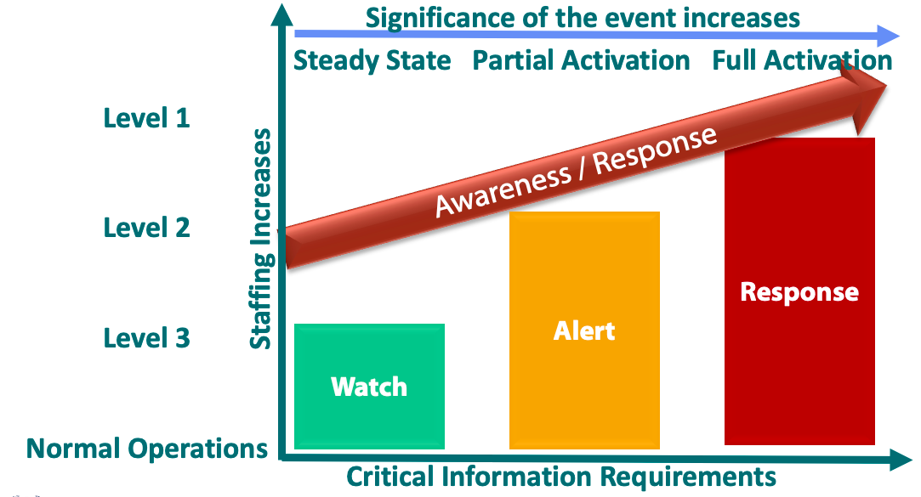
EOC Modes and Levels
EOC modes and levels define the steps to follow and the actions to take to address a public health threat (i.e. COVID-19).

Slide 6
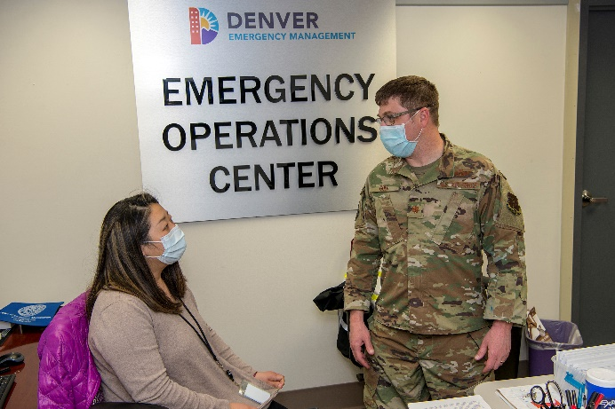
Keeping Staff Healthy
To effectively conduct operations, EOC staff need to stay healthy.
EOCs can take preventive steps against the spread of COVID-19 and other illnesses through all operation modes. Depending on local risk and health guidance, EOCs can:
Limit occupancy (some EOC staff work from home)
Require distance between occupants
Screen entrants for symptoms (i.e. temperature checks, checklists, etc.)
Require sick employees to stay home
Use masks or other face coverings
Clean workstations and office often
John Rohrer/ U.S. Air National Guard, 9 April 2020. Denver EOC, Colorado, USA.

Slide 7



EOC Operation Modes

Slide 8
EOC Operation Modes
Alert Mode
Upon standing up an EOC, an activation or operational mode is implemented based on the requirements of the public health emergency at the time.
Watch Mode
Alert Mode
Response Mode
Watch Mode

Slide 9
Watch Mode
A comprehensive emergency management program entails constant monitoring of potential public health hazards and threats.
If monitoring is conducted through the EOC, Watch Mode aligns with day-to-day routine operations.
Monitoring can also be carried out via a country or municipality’s routine operation and event-based surveillance systems.
Watch Mode

Slide 10
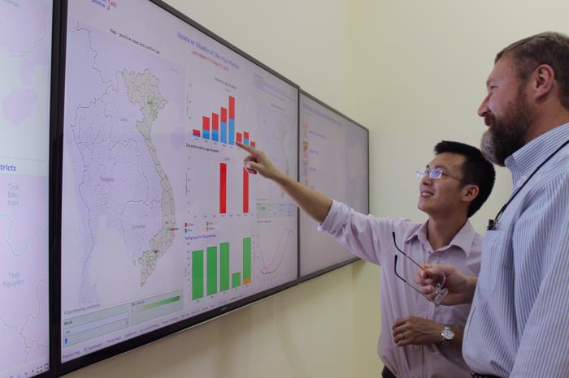
Watch Mode & Watch Team
During Watch Mode, the Watch Team is responsible for monitoring potential public health emergencies and reporting to the established authorities any significant threat to the safety of the population.
Watch Team refers to the members of the EOC staff that execute the activities associated with Watch Mode.

Slide 11
Watch Mode & Watch Team
In the Watch Team, there are two primary positions:
Duty Officer
Serves as the Watch Team Leader.
Emergency Communications Specialists or Watch Officers
Serve as the primary communications operators for the EOC, whether telephonic or electronic.

Slide 12
Watch Mode Activities
Principal activities to be conducted during Watch Mode are:
Monitoring for any domestic and/or global public health threats.
Maintaining a daily log of significant events.
Monitoring EOC reports and email inbox, forwarding relevant information to the pertinent authorities.
Provide support and respond to requests for information in accordance with established protocols and standard operating procedures.

Slide 13
Alert Mode
Alert Mode maintains a similar posture as Watch Mode, but with an enhanced level of awareness and focus on a specific emerging event.
It corresponds to the early “stand up” or “standby” phase of activation.
Jurisdictions without confirmed COVID-19 cases could consider maintaining readiness at Alert Mode, given the global scale of transmission.
Alert Mode

Slide 14

Alert Mode
Alert Mode results in:
Event-specific planning and initial mobilization of assets.
i.e. deployment of PPE to priority sites; training of laboratorians
Initiation of preparatory procedures for activating the Incident Management System (IMS)
Increased contact with external agencies and the deployment of staff to support daily operations.
“Just in time” refresher training
COVID-19 specific training

Slide 15
Response Mode
Response Mode refers to the activities required to manage the incident or emergency.
It corresponds to full activation of the EOC, including the IMS.
Response Mode

Slide 16
Response Mode
IMS provides a temporary organized structure that supports the response to the incident.
The term “IMS Response” can be used when referring to the Response Mode.
Transitioning to an IMS response requires the establishment of the following:
Central point for information management.
Routine communication channels to coordinate with other governmental agencies for response and the execution of potential missions.

Slide 17
Response Mode (continued)
Standardized internal reporting method to inform and coordinate information and resources with the lead Department/Ministry.
It is common to define different response “levels” within Response Mode, recognizing that different types of incidents will require different scales of response.

Slide 18
Response Mode
During the response, the EOC serves as the central public health incident management center for:
Coordinating and supporting staff (Management)
Planning
Operations
Logistics
Finance and administration

Slide 19
Response Mode – Management Staff
Management staff are responsible for the overall operation of the EOC and the coordination of response activities. These often include:
Public communication
Liaison with assisting agencies
Situation reporting
Resource mobilization
Essential roles include incident manager, EOC facility manager, and public communication officer.

Slide 20
Response Mode – Planning
The planning section is responsible for on-site and off-site planning to support the EOC.
On-site refers to the assignment of available resources (human and material) to achieve maximum effect.
Off-site refers to activities to contain the event, such as mapping and deployment of resources.
Other planning responsibilities include:
Data collection and processing
Operational communication
Anticipating future events

Slide 21
Response Mode – Operations
The operations section is responsible for the coordination, use of resources and technical aspect of the response operations to the public health emergency.
Operations functions can include the following response activities:
Triage
Contact tracing
Disease surveillance
Collection of epidemiological data
Community outreach and case management
Public health interventions

Slide 22
Response Mode – Logistics
Logistics is responsible for the tactical and operational resources required for the response to the public health emergency.
These may include:
Facilities
Personnel
Equipment (PPE, medical equipment, testing reagents, etc.)
Services (responder support, security, patient transportation, etc.)

Slide 23
Response Mode – Finance and Administration
The finance and administration section oversee all the financial and administrative tasks that facilitate the response to the emergency.
Some of these activities should include:
Establishing and monitoring budgets
Cash flow management
Resource costs tracking
Preparation of administrative records and contracts

Slide 24
EOC Response Levels

Slide 25
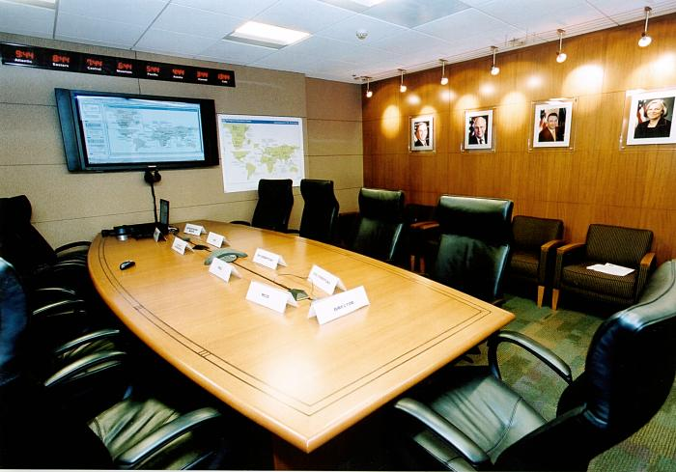

EOC Response Levels
An EOC’s response level (also sometimes referred to as “operational level”) will change over the course of its operation, resulting in either EOC deactivation or a change in response level.
Transitioning from one EOC activation level to another is based on the required level of effort (increase or decrease) to effectively manage the public health risk.
Response levels should be defined based on the EOC’s scope, mission, and available resources.

Slide 26
EOC Operational Levels – Level III
Level III – Lowest level of activation.
EOC staff may assist with the response but it is largely handled by Ministry/health agency subject matter experts.
The EOC should continue real-time monitoring of the situation.
For COVID-19, these activities might include:
Real-time collection and analysis of case data
Continuation of pre-event information flow
Daily reports
Development of alert messaging system and follow-up reporting

Slide 27
EOC Operational Levels – Level II
Level II – Enhanced Activation
Involves a larger number of EOC personnel, working alongside Ministry/health agency experts
For COVID-19, these activities might include:
Activities conducted during Level III
Detection and surveillance
Contact tracing
Epidemiological and laboratory analysis
Point-of-entry monitoring
Public warning and implementation of protective measures
Protective equipment for responders and care providers
Pharmacological treatment

Slide 28
EOC Operational Levels – Level I
Level I – Full Activation
Level I is reserved for the largest scale responses to a major threat.
For COVID-19, these activities might include:
All activities conducted during Level III and Level II
24/7 staffing of the EOC, and/or establishment of additional field EOC sites to coordinate specific efforts.
Deployment of specialized resources and units to manage response
Cross-border or regional coordination
Mass pharmaceutical prophylaxis or vaccination, if/when appropriate and available

Slide 29
References
FEMA Emergency Management Institute (2018, June 25) IS-700.B: An Introduction to the National Incident Management System. Retrieved from https://emilms.fema.gov/IS0700b/curriculum/1.html
WHO (2018) Handbook for Developing a Public Health Emergency Operations Centre. Retrieved from https://apps.who.int/iris/bitstream/handle/10665/277191/9789241515122-eng.pdf?sequence=1
WHO (2015) Framework for Public Health Emergency Operations Centres. https://www.who.int/ihr/publications/9789241565134_eng/en/
All photos retrieved from CDC's Public Health Image Library (accessed May 2020): https://phil.cdc.gov/

